Slide 1
Xamarin
Parameswari.E

Slide 2
Xamarin
Goals
Introduction to Xamarin
Xamarin vs. Hybrid Framework vs. Native Framework
Xamarin Development IDE – Visual Studio and Xamarin Studio
Xamarin Architecture
Introduction to Mono

Slide 3
Xamarin
Goals
Xamarin Development
Xamarin Cross platform solutions
Xamarin Family
Xamarin Development Approaches
Xamarin Advantages
Xamarin Disadvantages

Slide 4
Xamarin
Goals
Setup the Development Environment on Windows
Setting up Xamarin on Windows
Configuring Visual Studio and SDK for Android and Windows UWP
Configuring Visual Studio Emulator for Android and UWP
Verify your Xamarin environment on Windows

Slide 5
Xamarin
Goals
Setup the Development Environment on Mac
Setting up Xamarin on Mac
Configuring XCode, Visual Studio and Android SDK
Verify your Xamarin environment

Slide 6
Xamarin
Goals
Xamarin Project Types
Xamarin Shared Projects
Xamarin Portable Class Libraries

Slide 7
Xamarin
Goals
Xamarin Forms
Introduction to Xamarin Forms
Xamarin Forms Architecture
Xamarin Forms UI
Xamarin Forms UI Rendering Process
Xamarin vs. Xamarin Forms
PCL or Shared Project
Advantages of PCL over Shared Project

Slide 8
Xamarin
Goals
Xamarin Forms Fundamentals
Pages
Views
Layouts
Cells
Xamarin Forms Views/Controls and Views Alignment
Xamarin Forms Views/Controls
Comparing Xamarin Forms Controls with Native
Views Alignment

Slide 9
Xamarin
Goals
Xamarin Forms App Life Cycle
Xamarin Forms Application Methods
Comparing Android and iOS and Windows App Life Cycle
Layouts
Xamarin Forms Layouts
Layout Options
Stack Layout
Grid Layout
Relative Layout
Relative Layout - Constraint Expression Properties

Slide 10
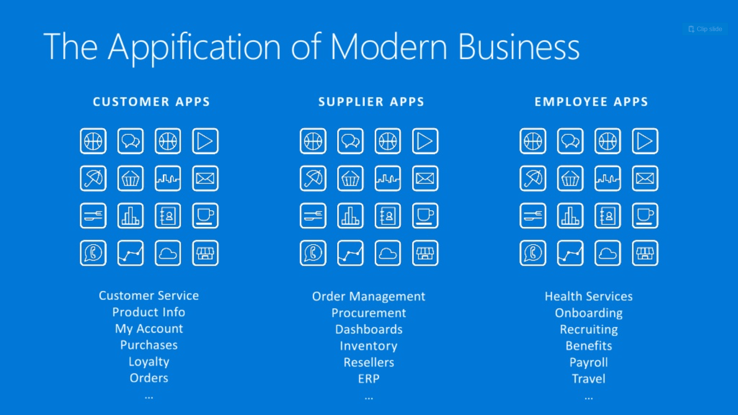
Applications

Slide 11
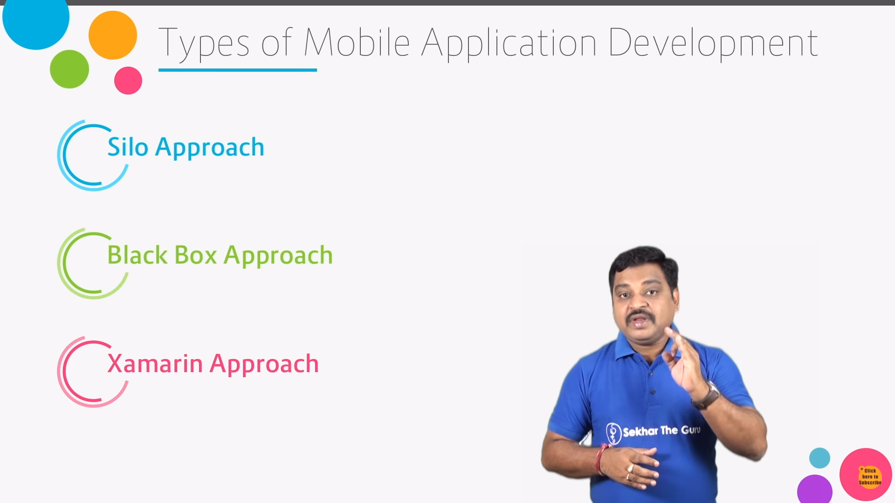
Types of Mobile Development

Slide 12
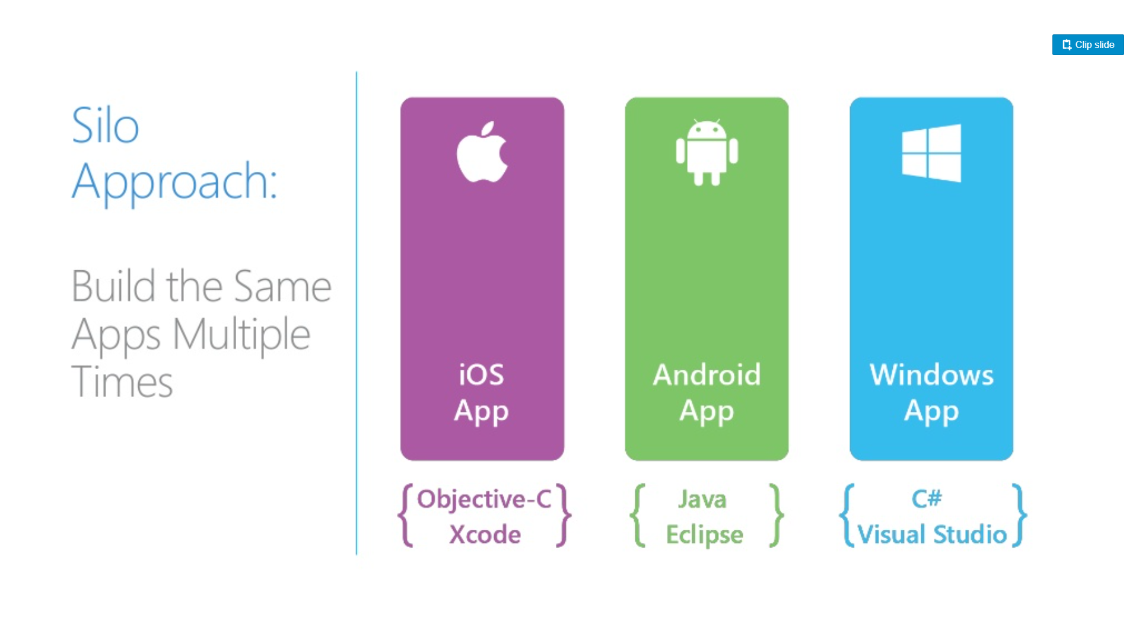
Types of Mobile Development

Slide 13
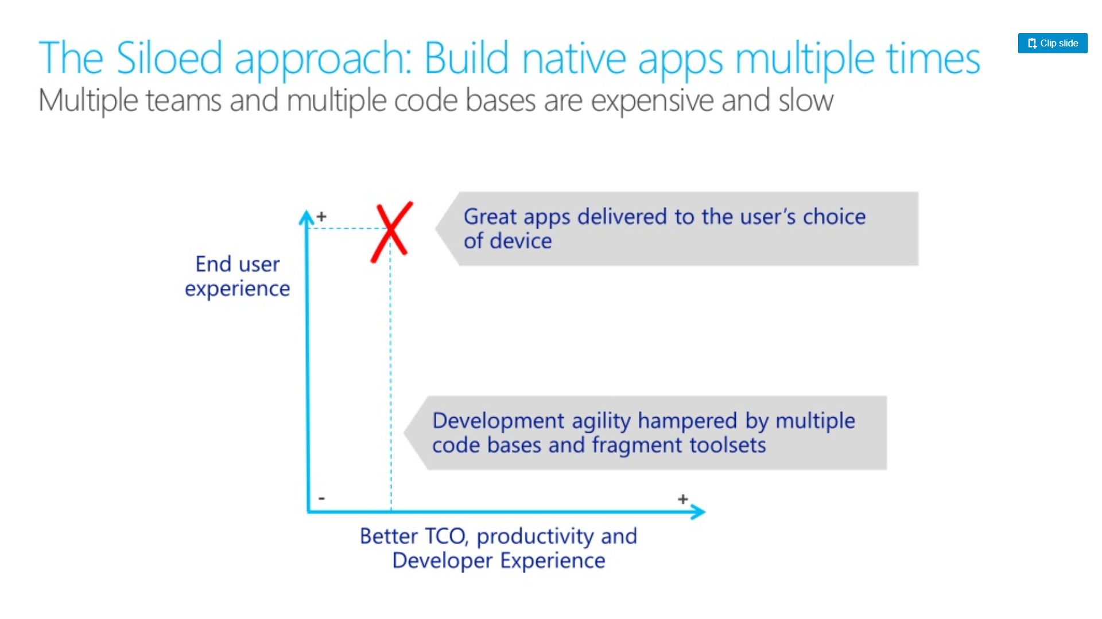
Types of Mobile Development

Slide 14
Types of Mobile Development
Silo Approach Pros and Cons
Pros
Great Application development can be built/delivered to the user’s platform
Cons
Multiple Teams
Multiple Code Base
Very Expensive

Slide 15
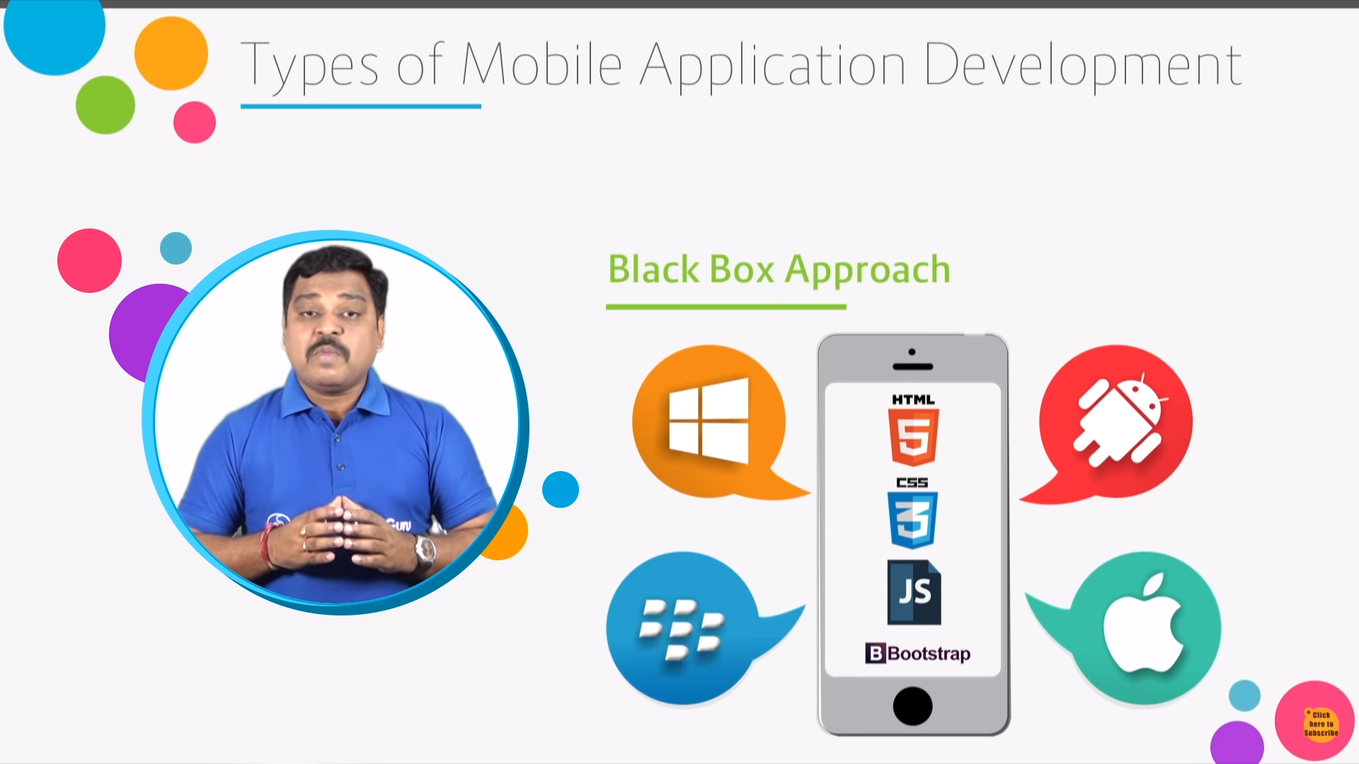
Types of Mobile Development

Slide 16
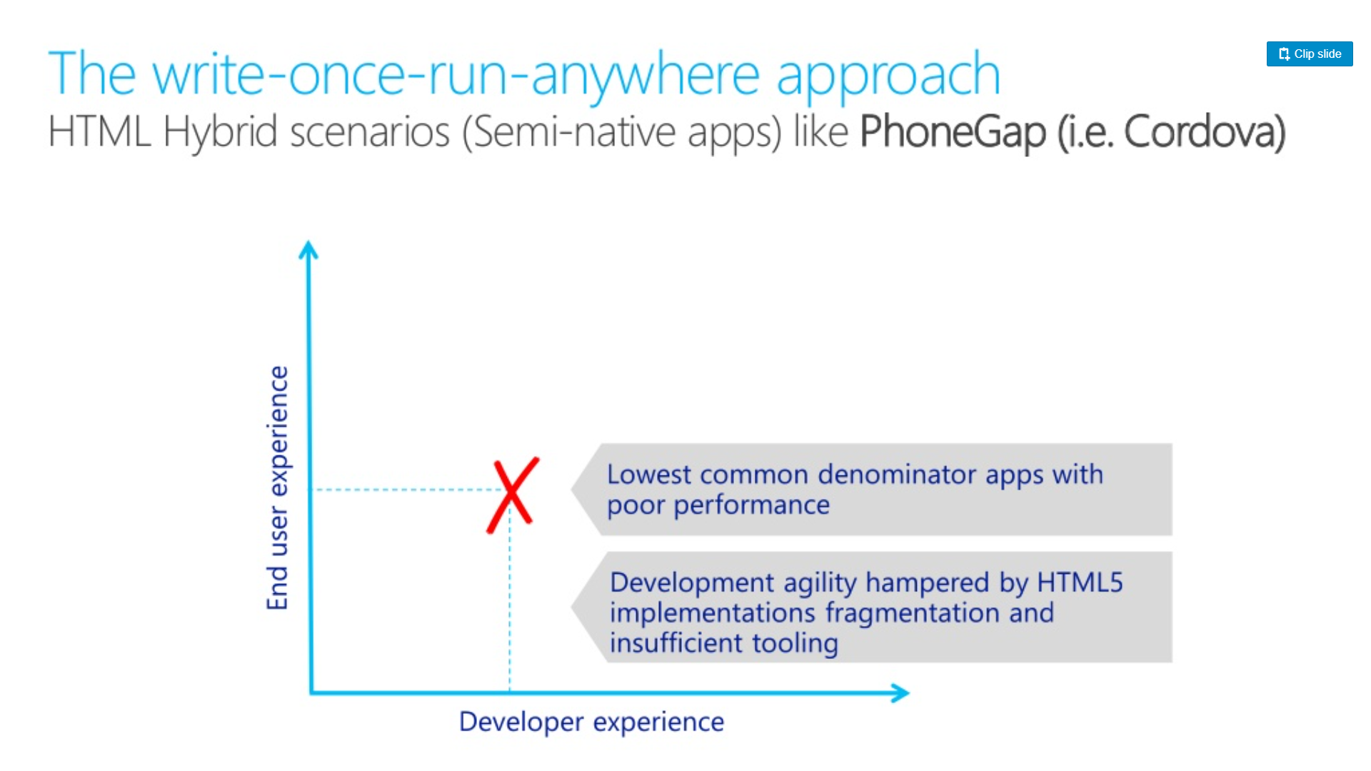
Types of Mobile Development

Slide 17
Types of Mobile Development
Black Box Approach Pros and Cons
Pros
Easy Development Process
Learning curve will be easy
Cons
Performance will be very low
Not suitable for enterprise applications

Slide 18
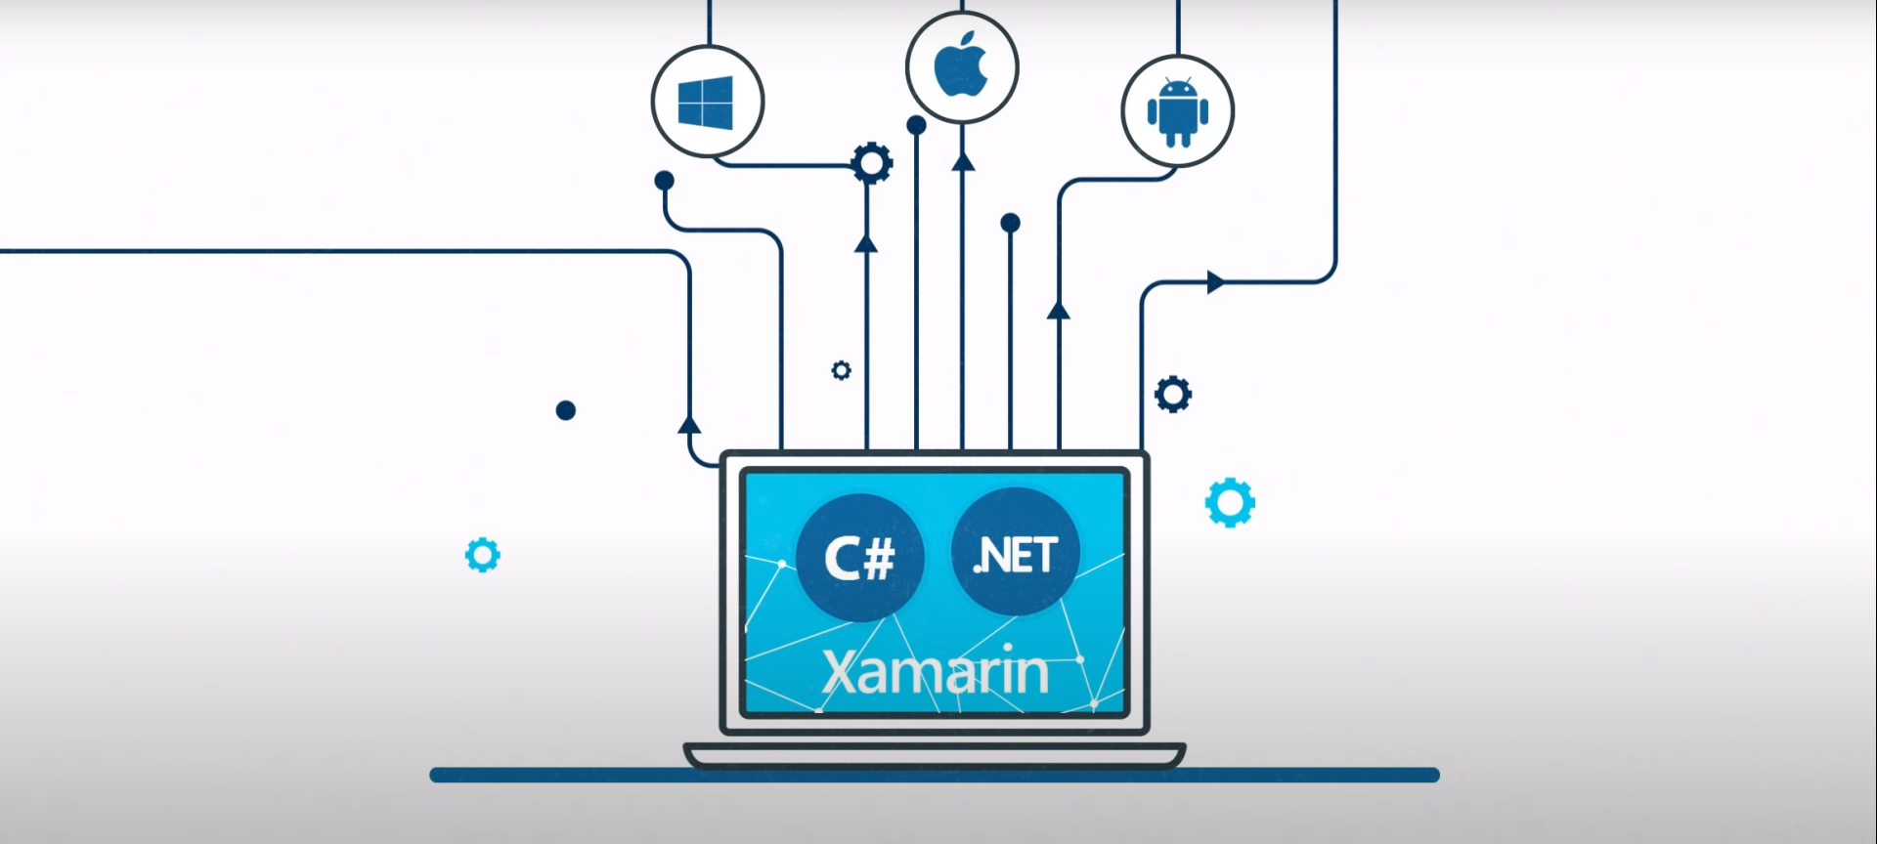
Xamarin Approach

Slide 19
Types of Mobile Development
Xamarin Approach
Traditional Application Development
Cross Platform Application Development

Slide 20
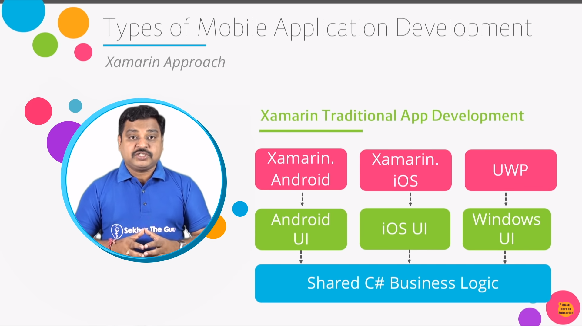
Types of Mobile Development

Slide 21
Types of Mobile Development
Xamarin Approach Pros and Cons
Pros
Great Application can be built
Learning curve will be reduced
Cons
Need to have some basic on native platform
UI has to be created separately for every platform

Slide 22
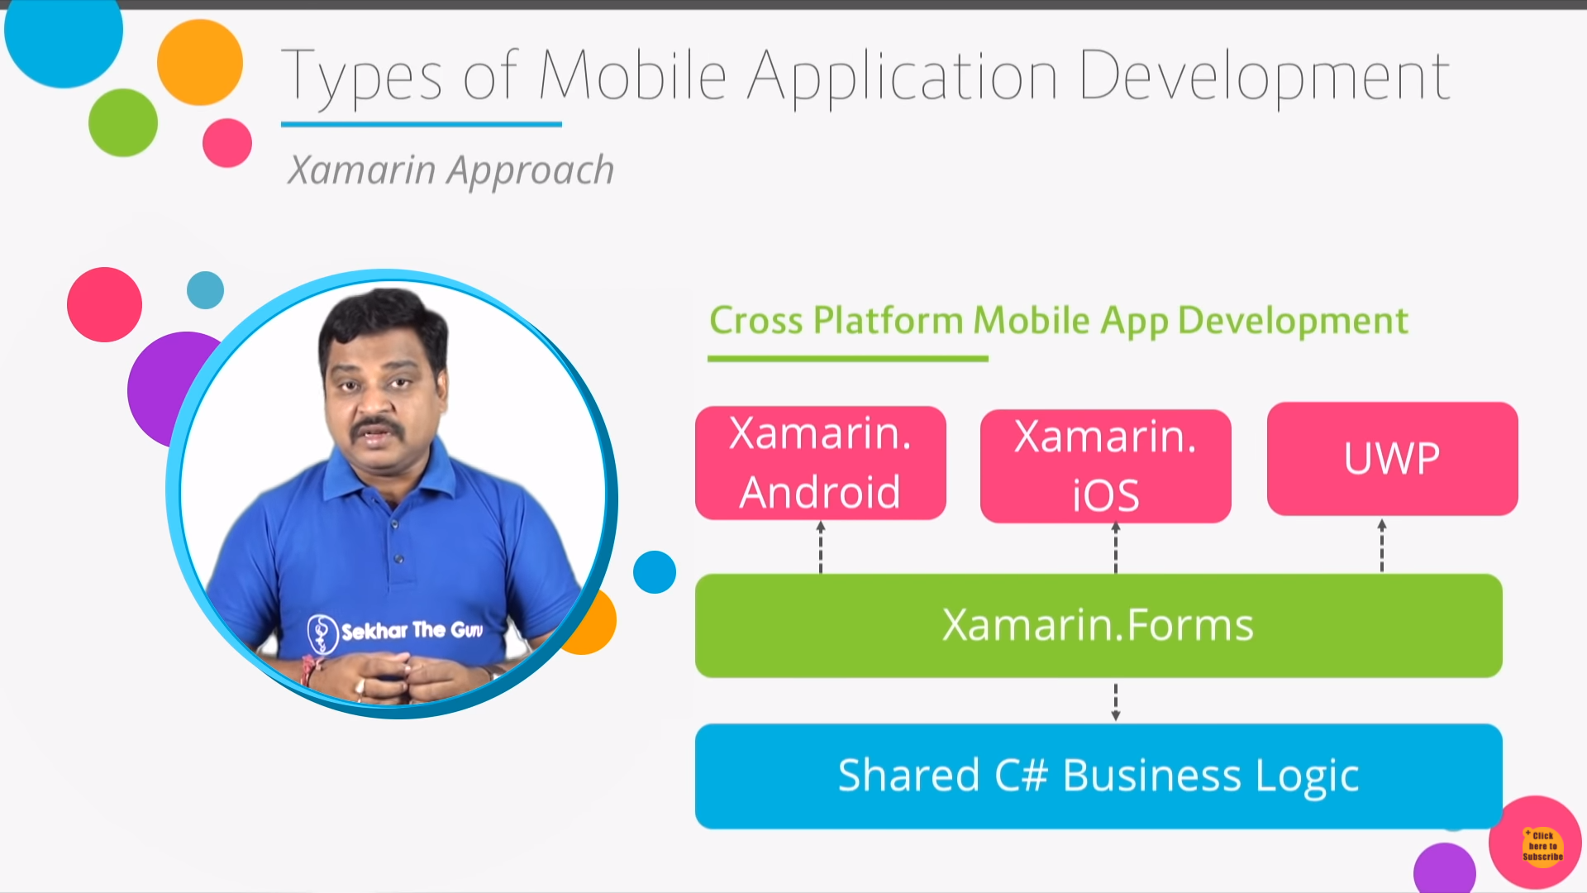
Types of Mobile Development

Slide 23
Types of Mobile Development
Xamarin Approach Pros and Cons
Pros
Business Logic and UI will be shared
Single codebase
Single Team
Development time will be faster
Native Apps will be developed
Cons
Limited in capabilities
Performance will be slightly slow

Slide 24
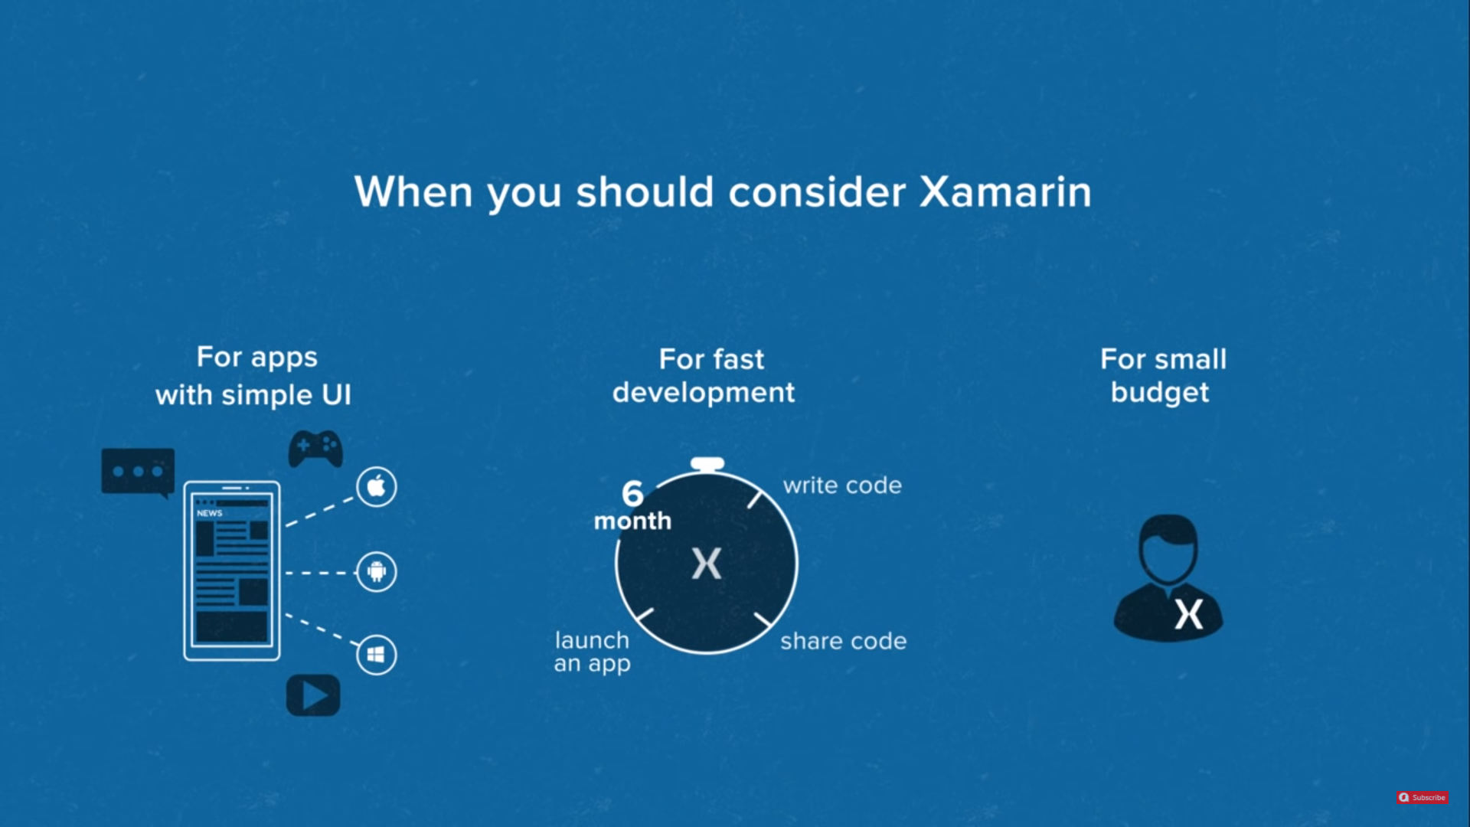
When you should consider Xamarin

Slide 25
Introduction to Xamarin
Xamarin is a software company which is originated in 2011.
Xamarin was acquired by Microsoft in 2016.
Xamarin provides the developers with the whole range of tools which can be used for the development of the cross-platform mobile application.
It is a framework to develop a cross platform mobile application using C#.
There are various frameworks which offer the cross-platform app development.
It uses HTML and JavaScript. Using these frameworks, we can develop apps like a website for mobile app using JS libraries, the website is packed in a container which gives the feel of a native app.

Slide 26
Introduction to Xamarin
Xamarin is different because it offers a single language C# and runtime, which works on three mobile platforms (Android, iOS, and Windows).
Through Xamarin, we develop a mobile app whose look and feel is completely native.
In Xamarin, we write one C# codebase which has access to all the features which is available for native SDK.

Slide 27
Xamarin Development IDE – Installation Of Xamarin
Install Visual Studio
Step 1: Make sure our computer is ready for Visual Studio
To download the Visual Studio, we should focus on the system requirement to install the Visual Studio in our system.
Here is the product support minimum system requirement is:
Visual Studio Enterprise 2019
Visual Studio Team Foundation Server Office Integration 2019
Visual Studio Professional 2019
Visual Studio Community 2019

Slide 28
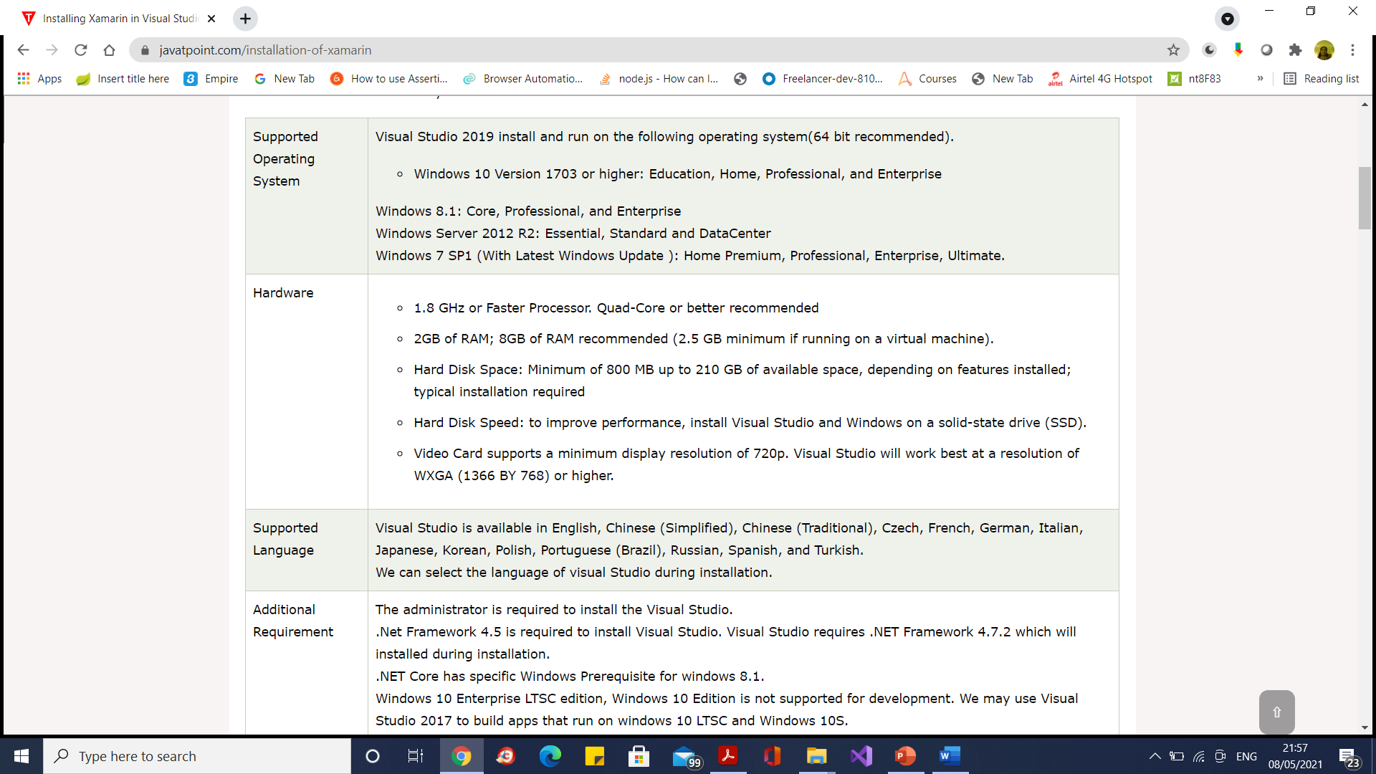
Xamarin Development IDE – Installation Of Xamarin

Slide 29
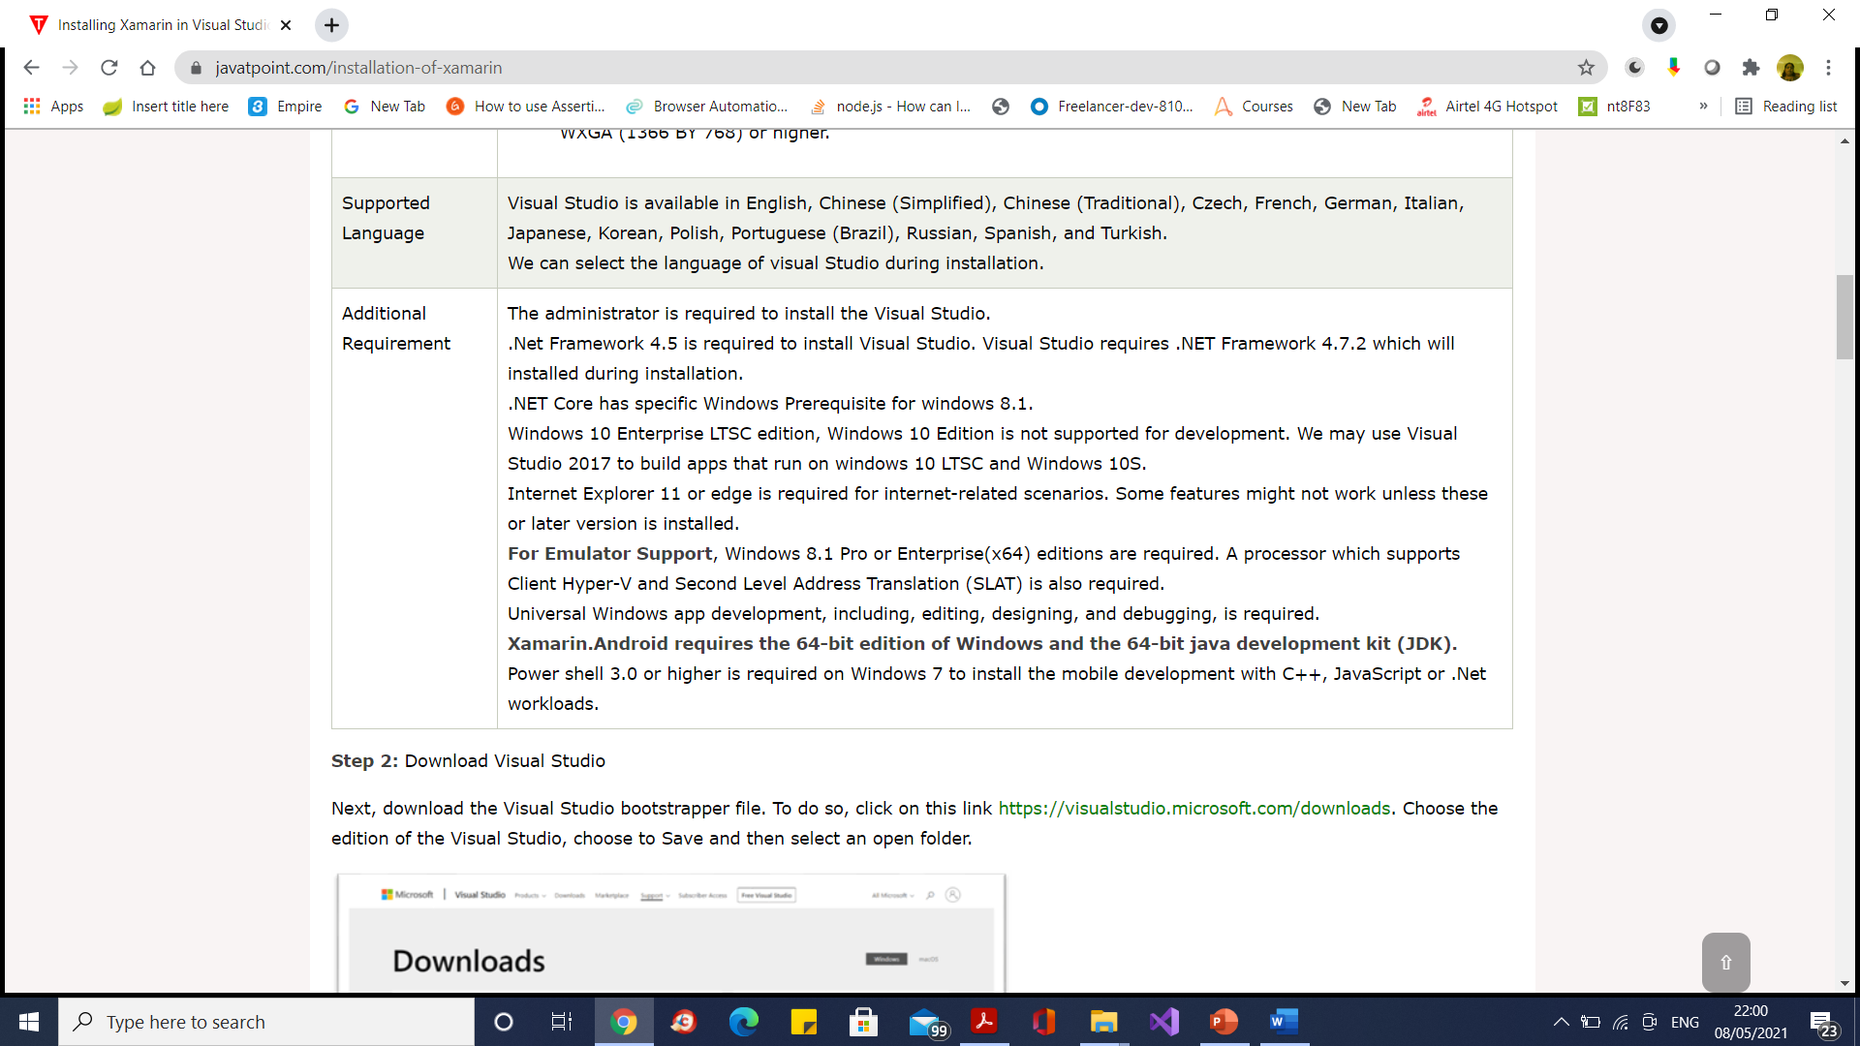
Xamarin Development IDE – Installation Of Xamarin

Slide 30
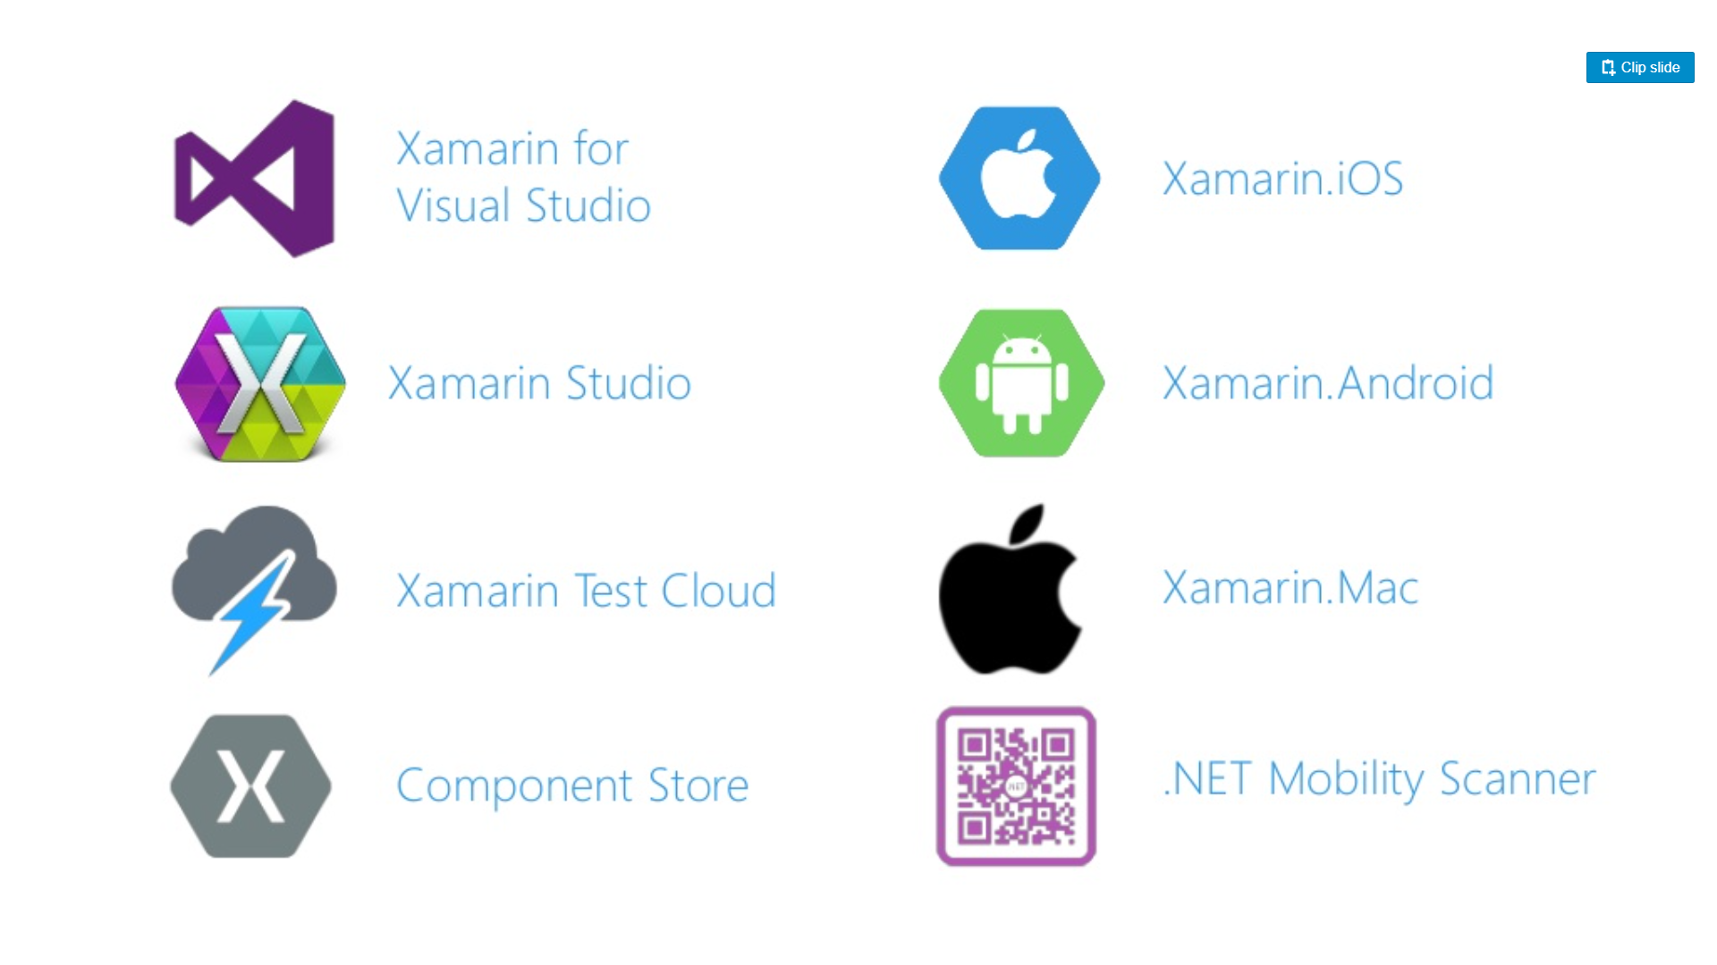
Xamarin Environments

Slide 31
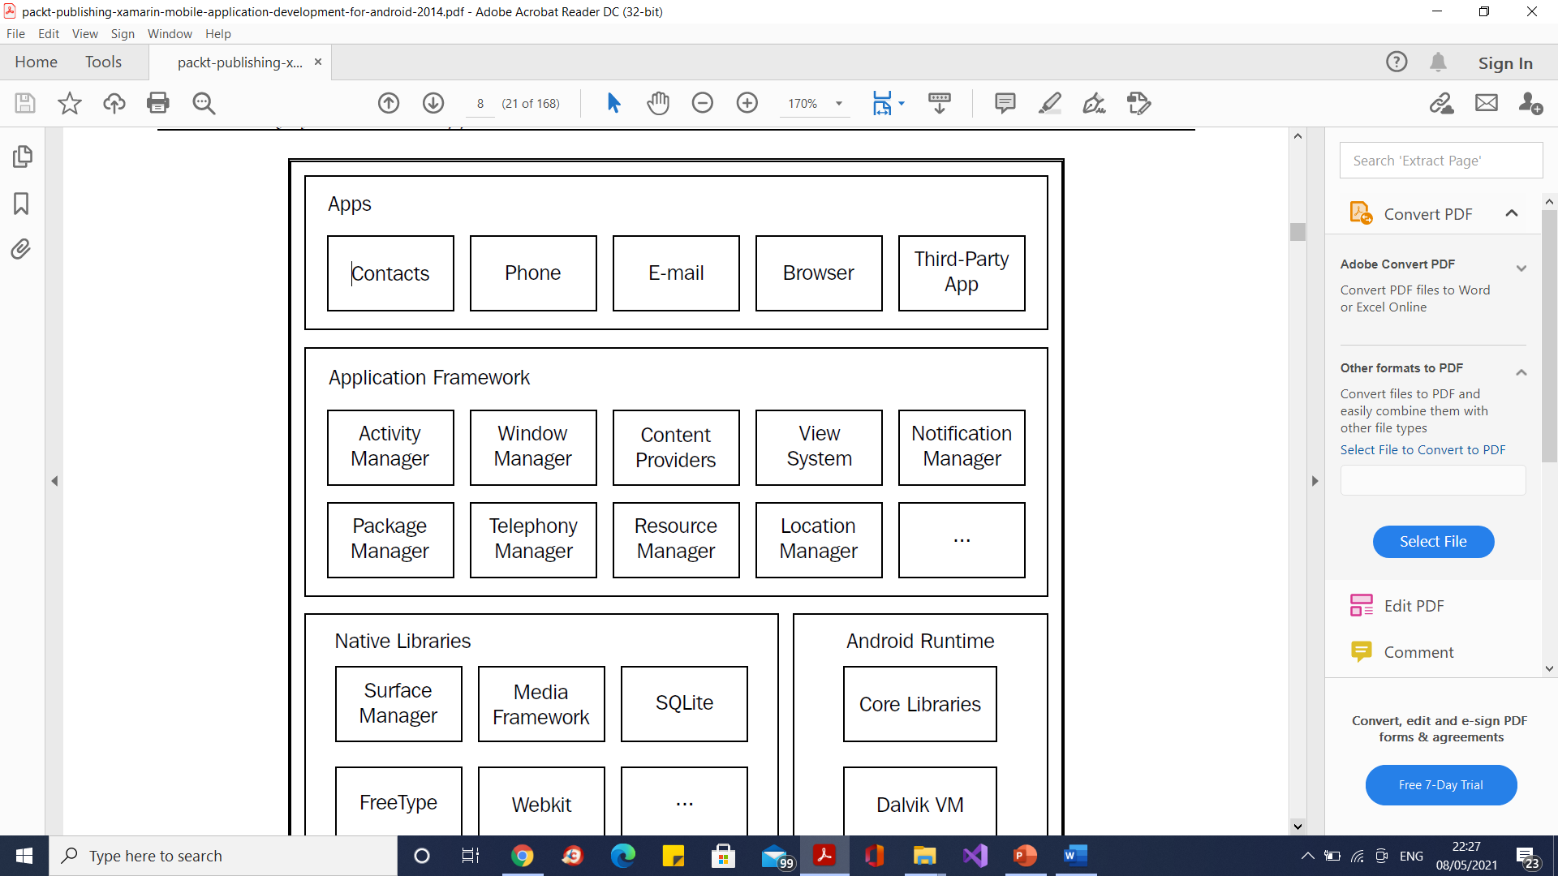
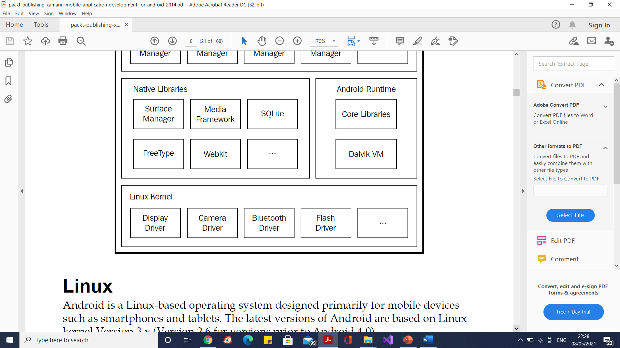
Anatomy of Android

Slide 32
The Android runtime
Android apps run within the Dalvik Virtual Machine (Dalvik VM), which is similar to a Java VM but has been optimized for devices with limited memory and processing capacity.
Android apps are initially compiled to the Java byte code using the Java compiler, but they have an additional compilation step that transforms the Java byte code to the Dalvik byte code, suitable to run within the Dalvik VM.

Slide 33
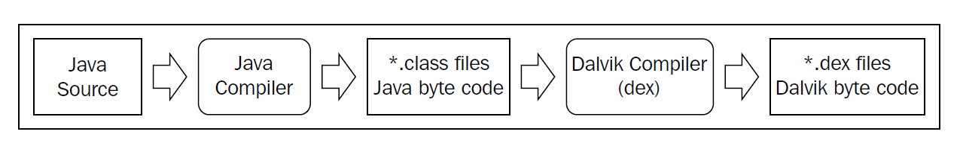
The Android runtime

Slide 34
What is Mono?
Mono is a free open-source .NET framework developed by Novell and owned by Xamarin a company of Microsoft.
First time it was introduced in June 30, 2004. The purpose of Mono project is to run .NET based applications on cross-platform including Linux, Android, mac etc.

Slide 35
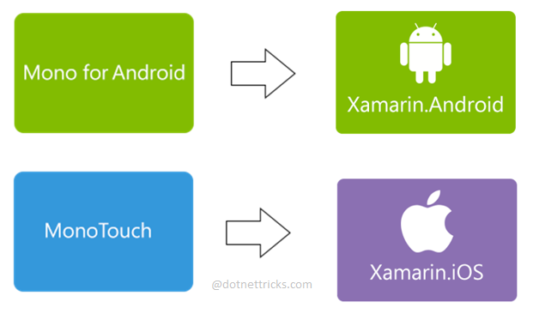
What is Mono?

Slide 36
What is Mono?
Mono is an open source, cross-platform implementation of a C# complier, and a Common Language Runtime (CLR) that is binary compatible with Microsoft .NET.
The Mono CLR has been ported to many platforms, including Android, most Linux distributions, BSD, OS X, Windows, Solaris, and even some game consoles such as Wii and Xbox 360.
In addition, Mono provides a static compiler that allows apps to be compiled for environments such as iOS and PS3.

Slide 37
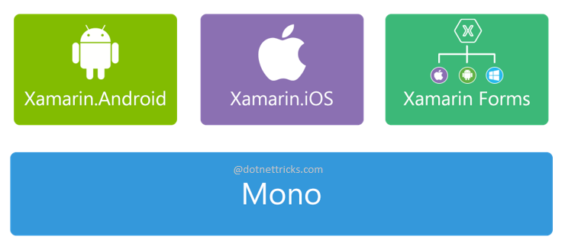
Xamarin Architecture

Slide 38
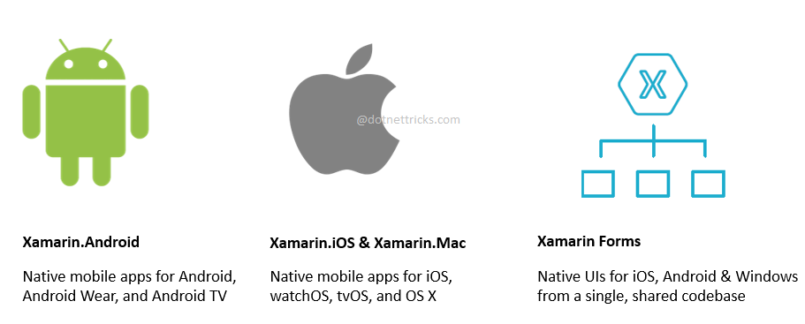
Xamarin Family

Slide 39
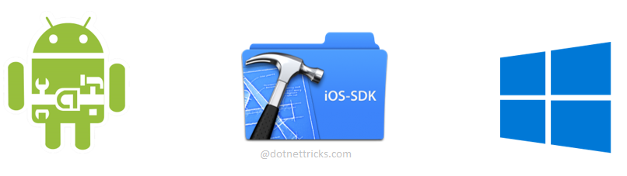
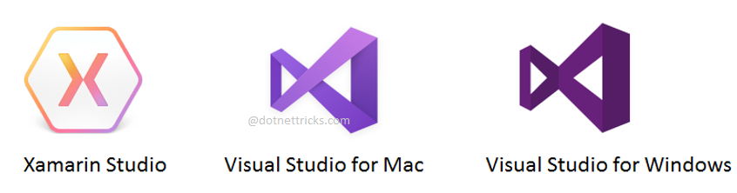
Development SDKs
Xamarin Apps Development IDEs

Slide 40
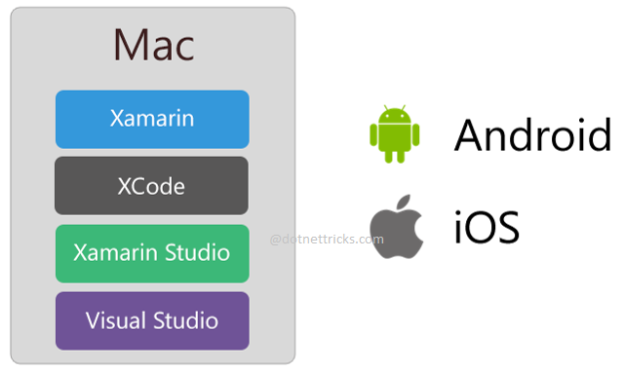
Development with Mac Machine

Slide 41
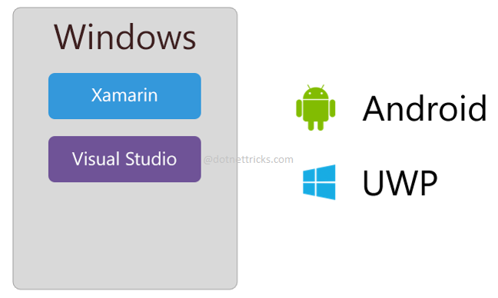
Development with Windows Machine

Slide 42
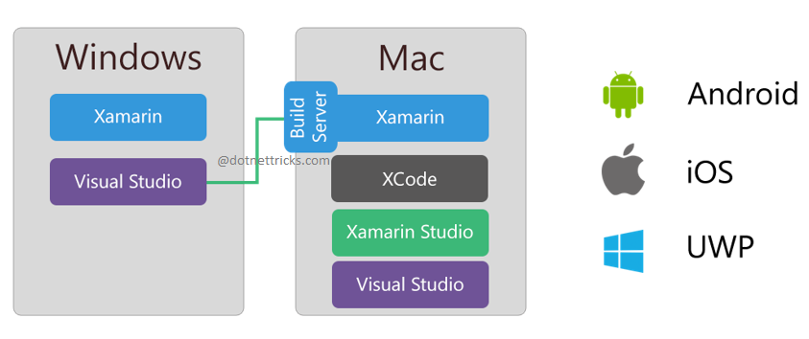
Development with Windows and Mac Machine

Slide 43
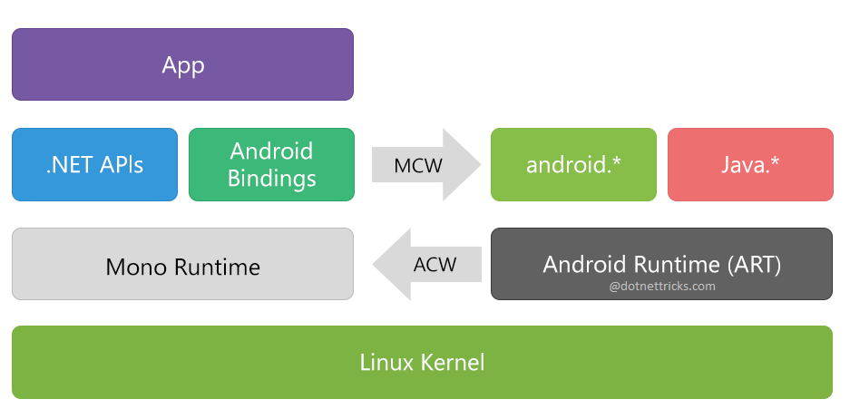
Xamarin Architecture

Slide 44
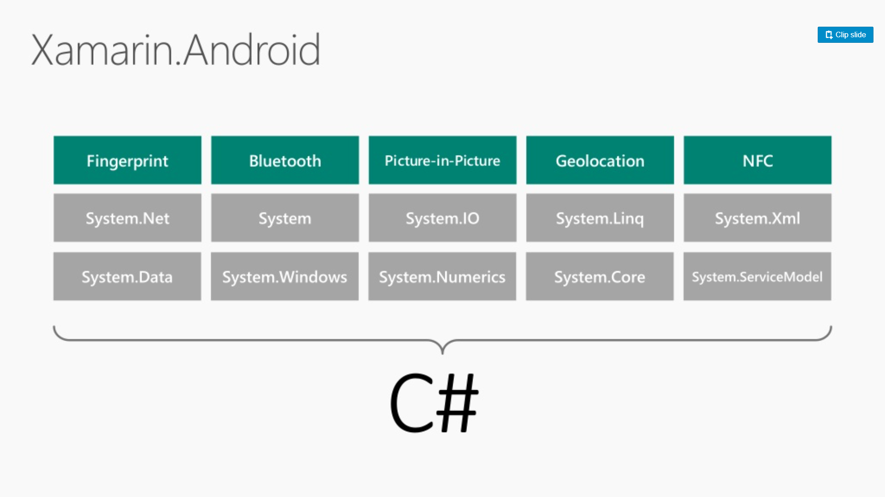
C# packages

Slide 45
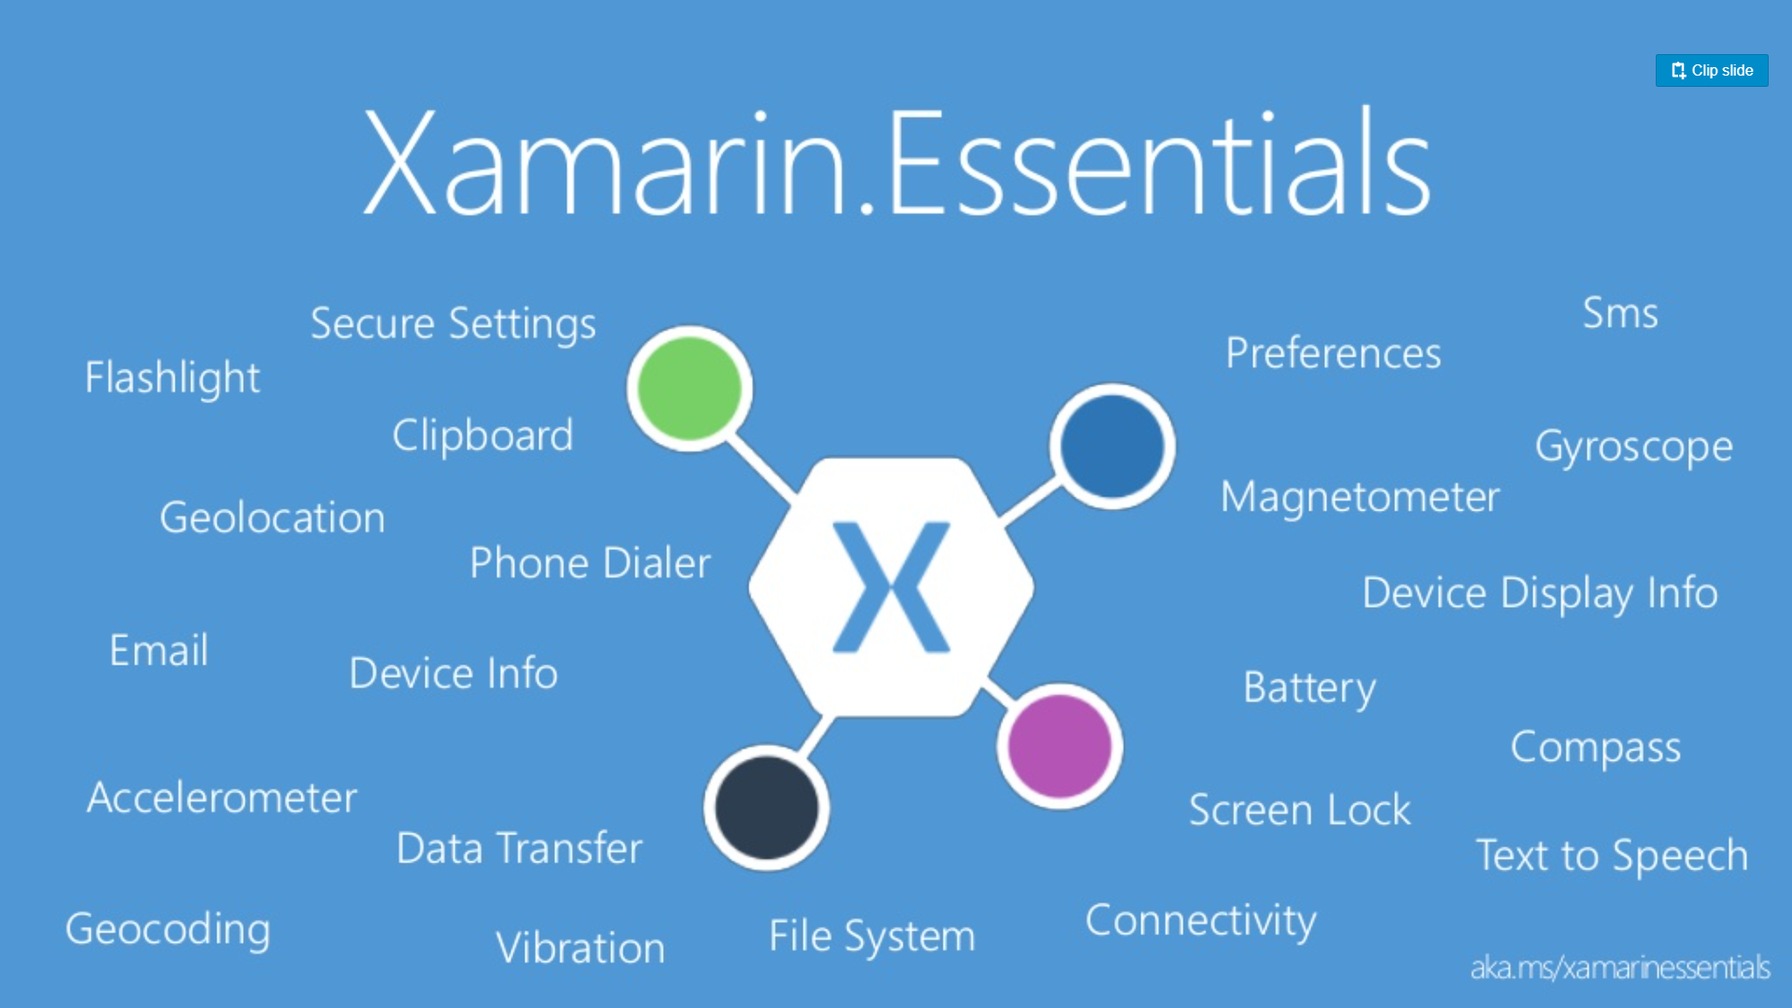
Xamarin Essentials

Slide 46
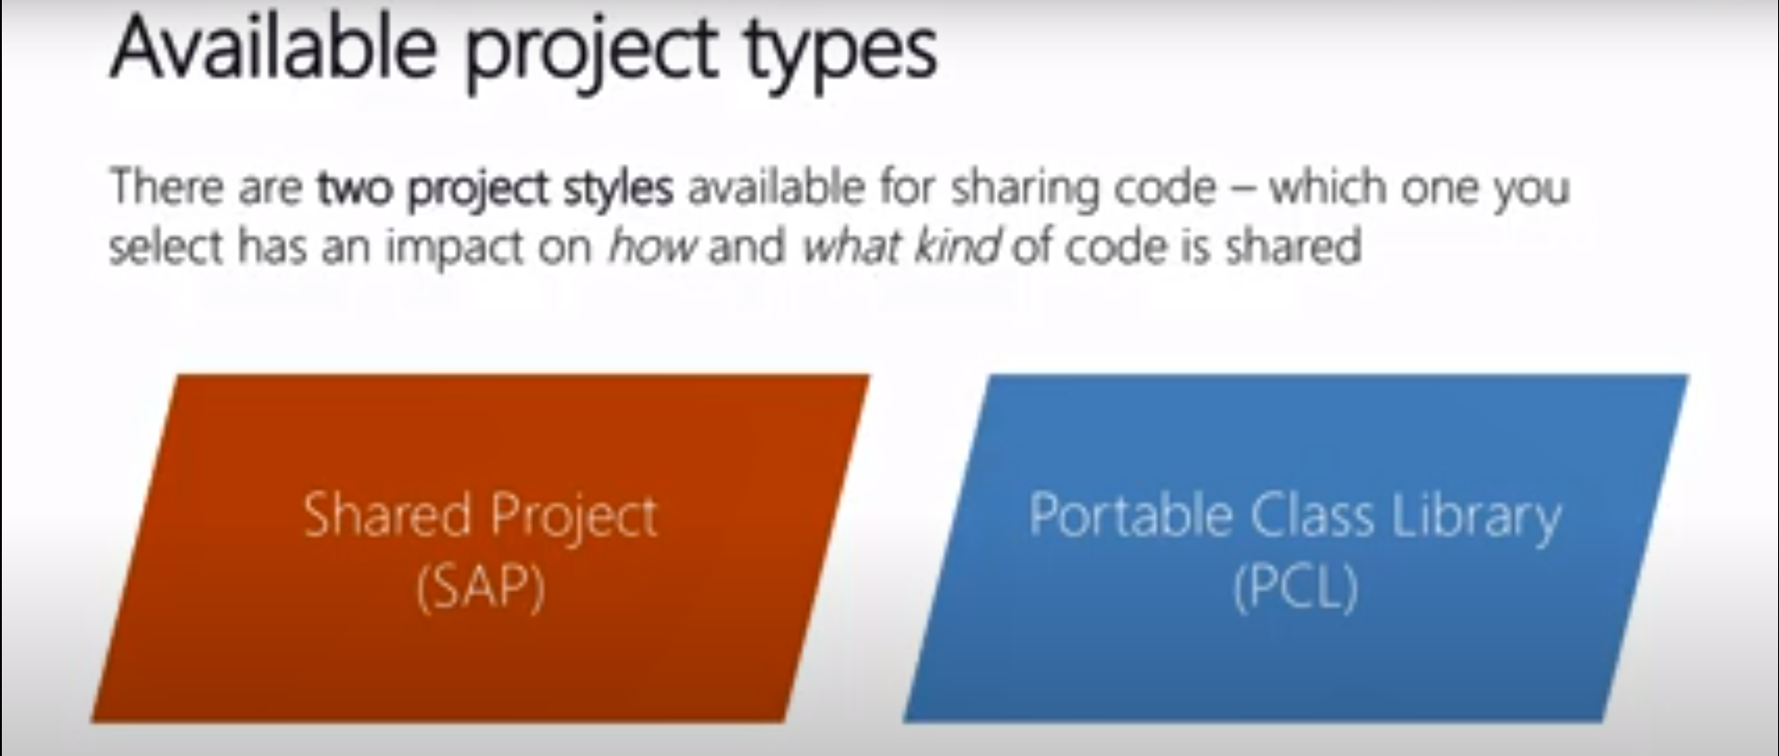
Xamarin Project Types

Slide 47
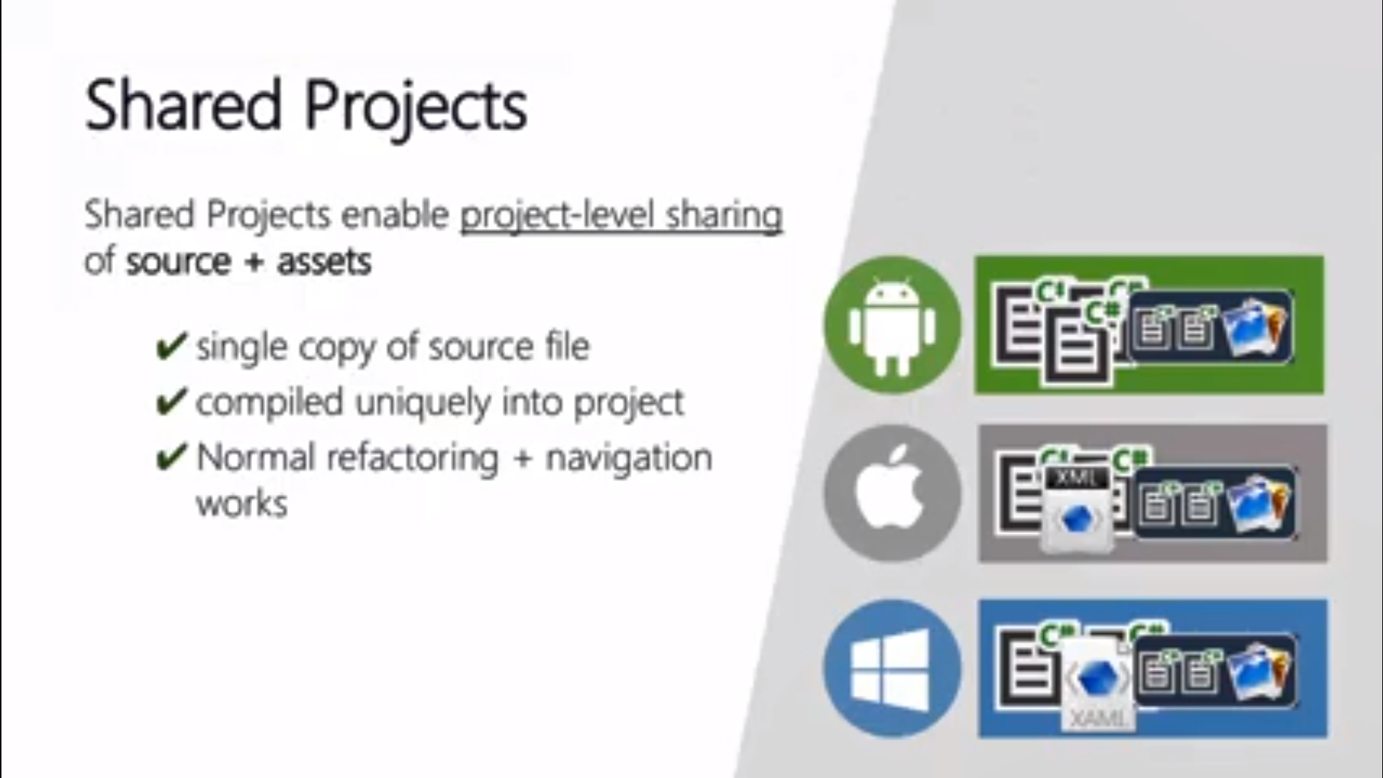
Xamarin Project Types

Slide 48
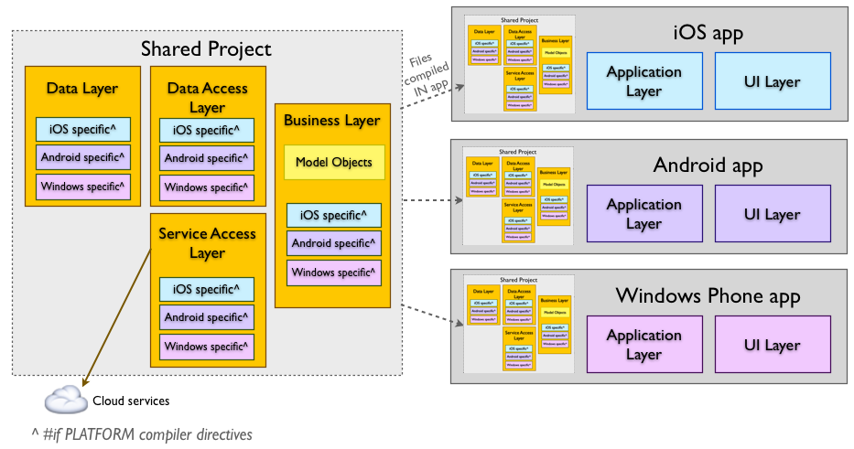
Shared Projects code sharing

Slide 49
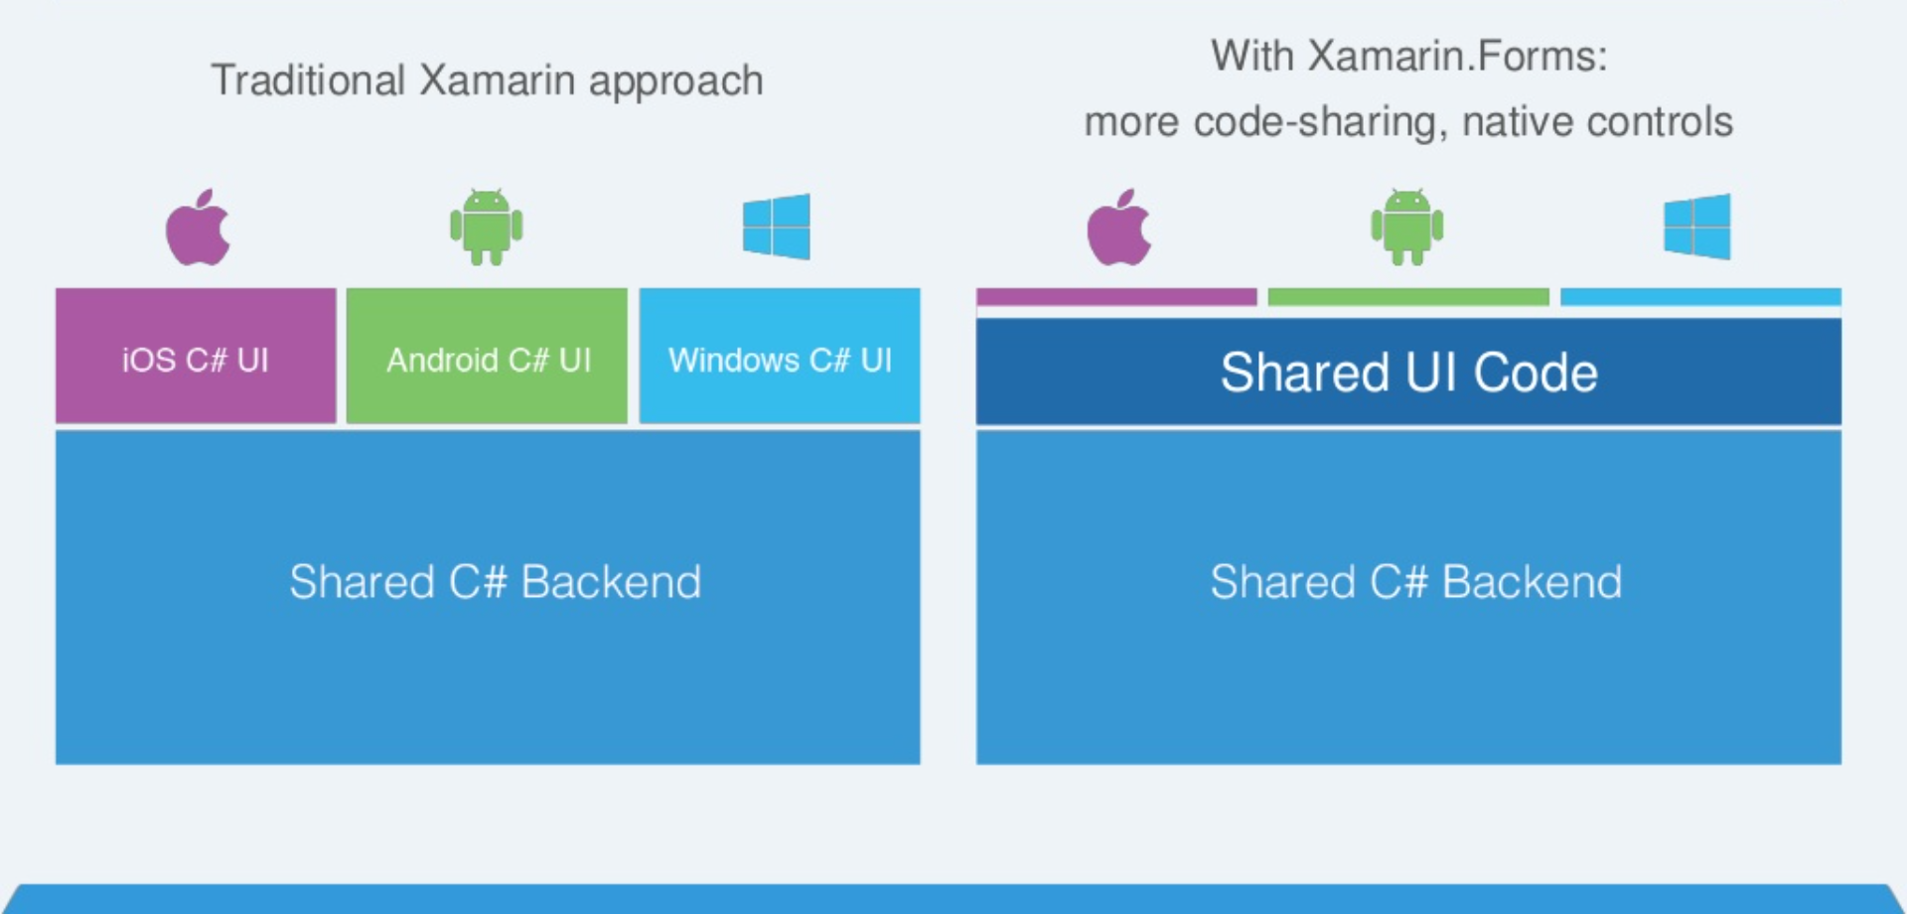
Shared Projects code sharing

Slide 50
Portable Class Libraries (PCL)
PCL projects target specific profiles that support a known set of BCL classes/features.
When you create an Application Project or a Library Project, the resulting DLL is restricted to working on the specific platform it is created for.
This prevents you from writing an assembly for a Windows app, and then re-using it on Xamarin.iOS and Xamarin.Android

Slide 51
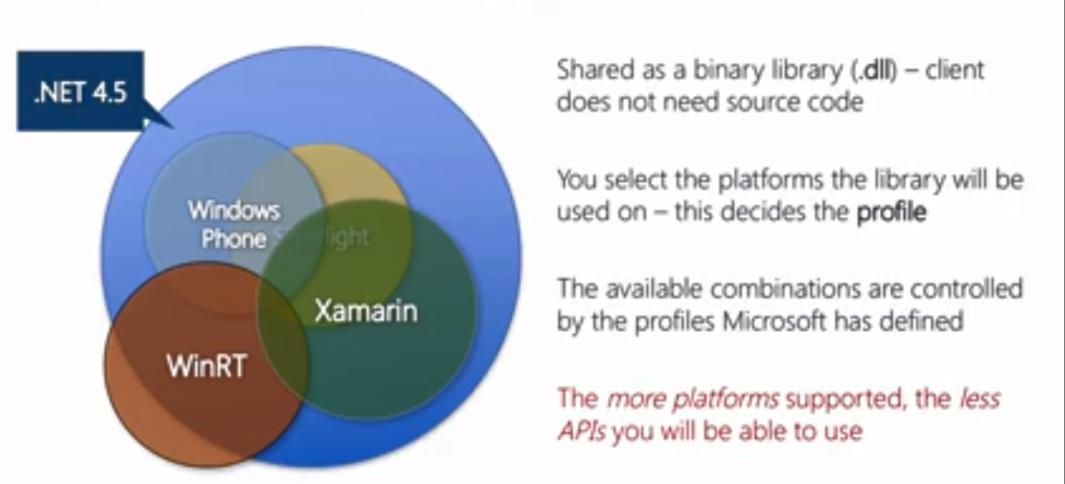
Portable Class Libraries (PCL)

Slide 52
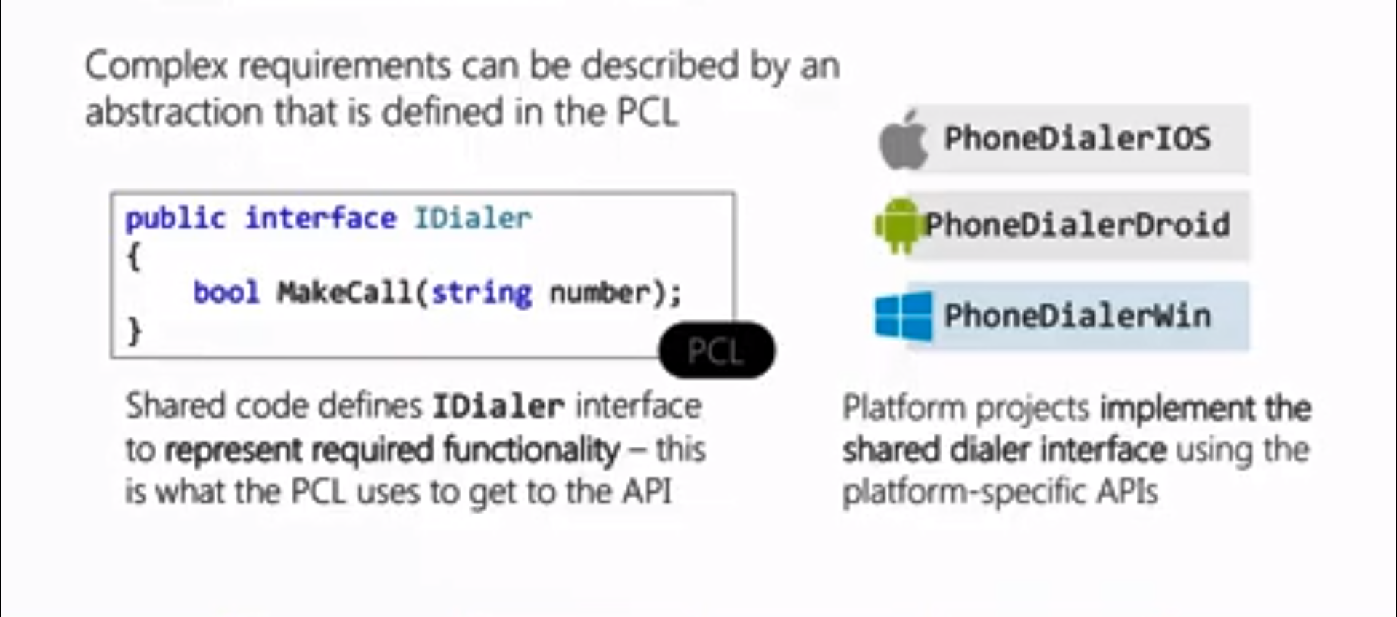
Portable Class Libraries (PCL)

Slide 53
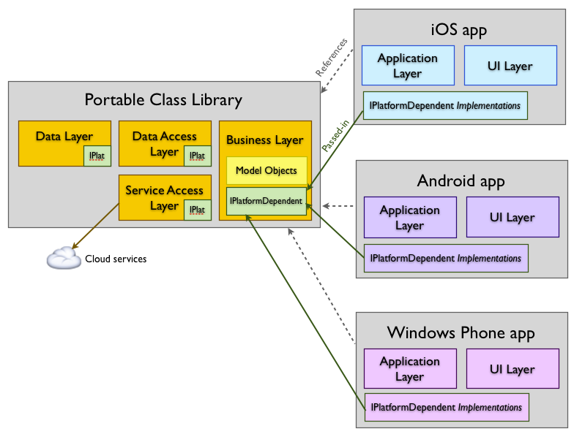
Portable Class Libraries (PCL)

Slide 54
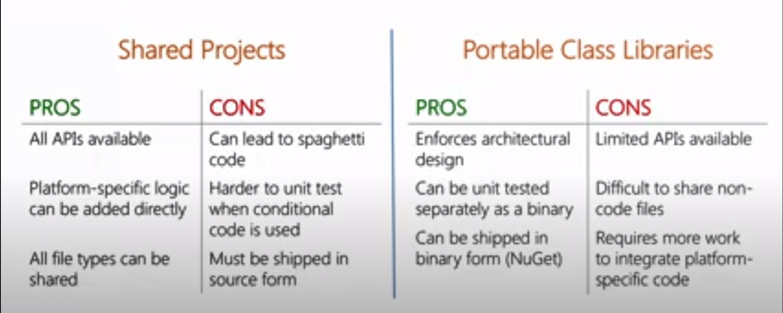
Portable Class Libraries (PCL)

Slide 55
Xamarin Forms
Xamarin.Forms is an open-source, cross-platform framework acquired by Microsoft for building Android, iOS, and windows app with .NET from a single shared codebase.
We use Xamarin. Forms built-in Pages, layouts, and controls to build and design mobile apps from a single API that is highly extensible.
Subclass any control to customize the behavior or to define our controls, layouts, pages, and cells to make our apps pixel perfect.
One of the greatest benefits of Xamarin.Forms is that it gives us the ability to develop native mobile apps for several platforms simultaneously

Slide 56
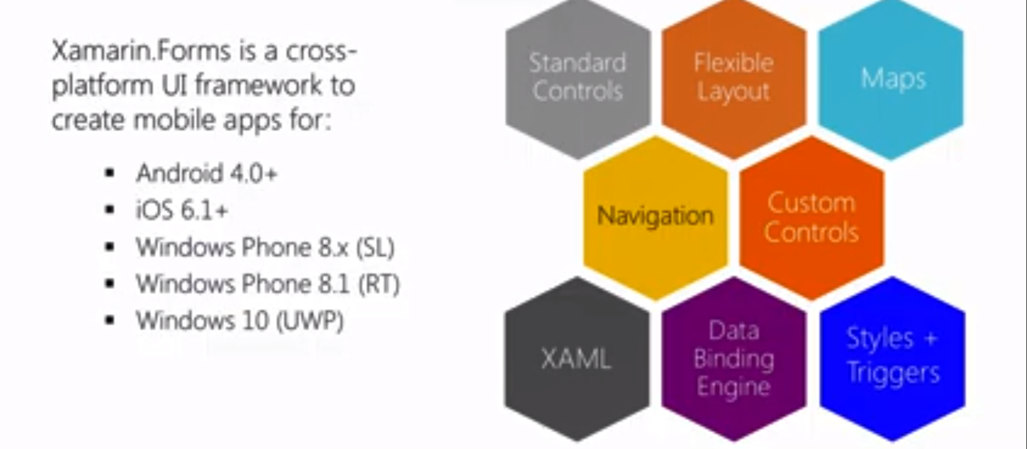
Xamarin.forms

Slide 57
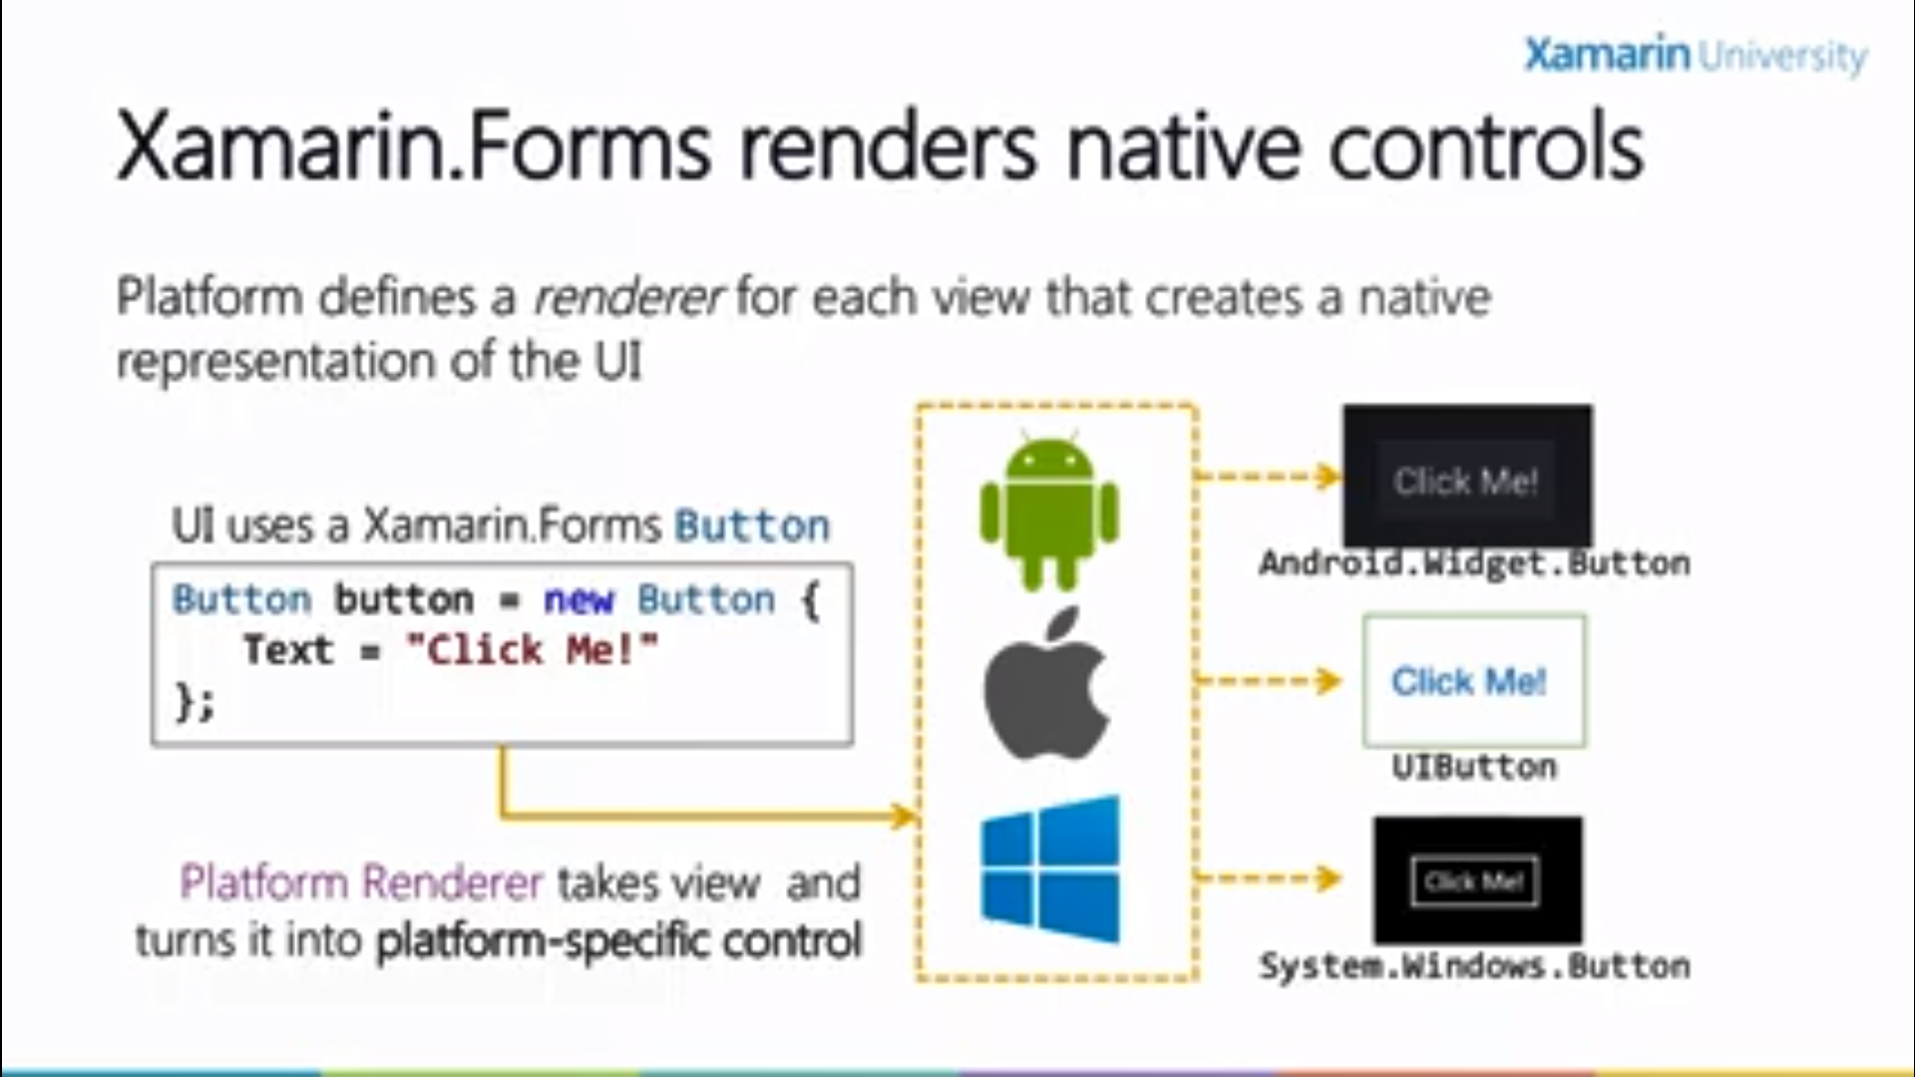
Xamarin.forms

Slide 58
Xamarin Forms Architecture
Xamarin.Forms solution architecture: One app for three platforms

Slide 59
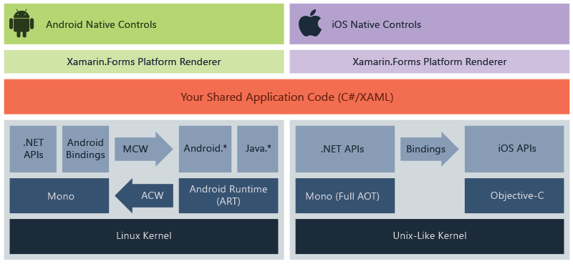
Xamarin Forms Architecture
Xamarin.Forms solution architecture: One app for three platforms

Slide 60
Choosing Xamarin.Forms or a Platform-Specific UI
Use Xamarin.Forms for the following:
Learning Xamarin: If we’re new to mobile development using C# then Xamarin. Forms is a great way to get started!
Cross-platform scaffolding: When building cross-platform apps, Xamarin.Forms is useful to build out the scaffolding of your app, as a rapid-application development toolset.
Basic Business Apps: Xamarin.Forms does these things well: basic data display, navigation, and data entry. This is a good fit for many business apps.
Basic design: Xamarin.Forms provides controls with baseline design features, facilitating basic visual formatting.

Slide 61
Choosing Xamarin.Forms or a Platform-Specific UI
Use Xamarin.Forms for the following:
Simple cross-platform screens: Xamarin.Forms is great for creating fully functional basic screens. For more complex screens, leverage Xamarin.Forms custom renderers for platform-specific details.

Slide 62
Choosing Xamarin.Forms or a Platform-Specific UI
Use a platform-specific UI (Xamarin.iOS or Xamarin.Android) for:
Complex screens: When an entire screen (or an entire app) requires a nuanced and complex design and UI approach, and Xamarin.Forms isn’t quite up to the task,go with a platform-specific UI using Xamarin.Android and Xamarin.iOS.
Consumer Apps: Platform-specific UI has everything a developer needs to create a consumer app with complex visual design, nuanced gesture sensitivity, and high-end graphics and animation.

Slide 63
Choosing Xamarin.Forms or a Platform-Specific UI
Use a platform-specific UI (Xamarin.iOS or Xamarin.Android) for:
High-design: This approach provides complete native UI APIs with low-level access to design properties on each control, allowing for a high visual standard of design. Native animation and graphics are also available with this approach.
Single-platform apps: If we’re building for only one platform, and a cross-platform approach for your app is not important in the foreseeable future (a rare case even if you’re starting with one platform), consider using a platform-specific UI.
Unsupported platforms: Mac OS X, Windows Store, and WinRT apps are not currently supported by Xamarin.Forms at this time.

Slide 64
Use Both Approaches with Custom Renderers
Custom Renderers provide access to the lower-level, platform-specific, screen-rendering classes called Renderers, which use platform-specific controls to create all Xamarin.Forms screens.
Any Xamarin. Forms screen can be broken into platform-specific screens and classes using this approach.
This means we can write a Xamarin.Forms page or app, and customize it by platform whenever necessary.

Slide 65
Xamarin Forms Architecture
Xamarin.Forms architecture with custom renderers

Slide 66
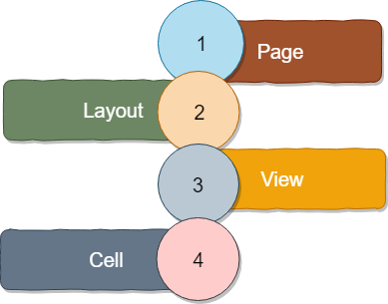
Xamarin.forms UI

Slide 67
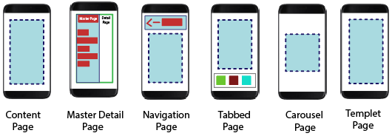
Xamarin.forms UI

Slide 68
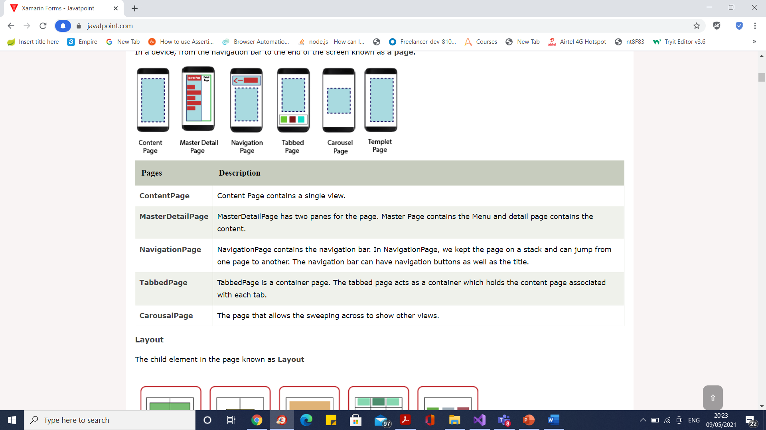
Xamarin.forms UI

Slide 69
Xamarin.forms UI

Slide 70
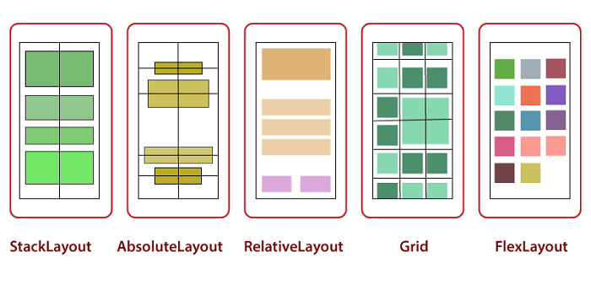
Xamarin.forms UI

Slide 71
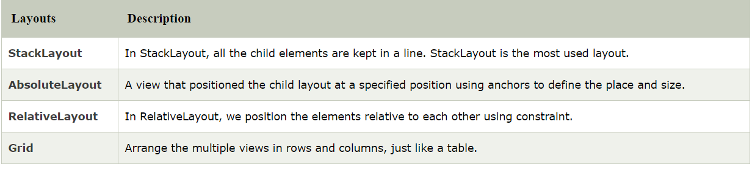
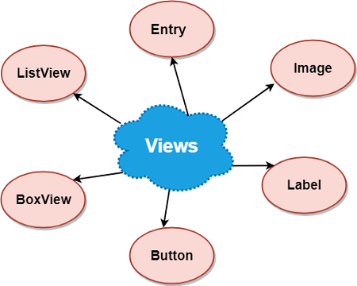
Xamarin.forms UI

Slide 72
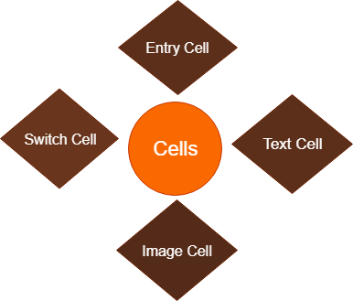
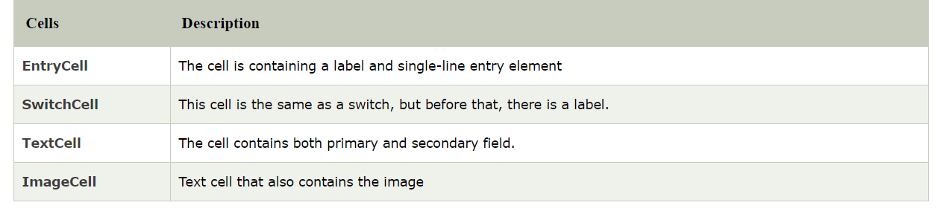
Xamarin.forms UI

Slide 73
Xamarin Form Solution

Slide 74
Application Lifecycle Methods: OnStart, OnSleep, and OnResume
When the user clicks the Back or Home (or App Switcher) buttons on their device, an app moves into the background. When they reselect the app again, it resumes and moves back into the foreground.
The starting of an app, the progression of the app from the foreground into a background state then back into the foreground again, until termination, is called the application lifecycle.
The Application class includes three virtual methods to handle lifecycle events:
• OnStart – Called when the app is first started
• OnSleep – Called each time the app is moved into the background
• OnResume – Called when the app is resumed after being in the background
OnSleep is also used for normal application termination (not a crash). Any time an app moves into a background state, it must be assumed that it may never return from that state.

Slide 75
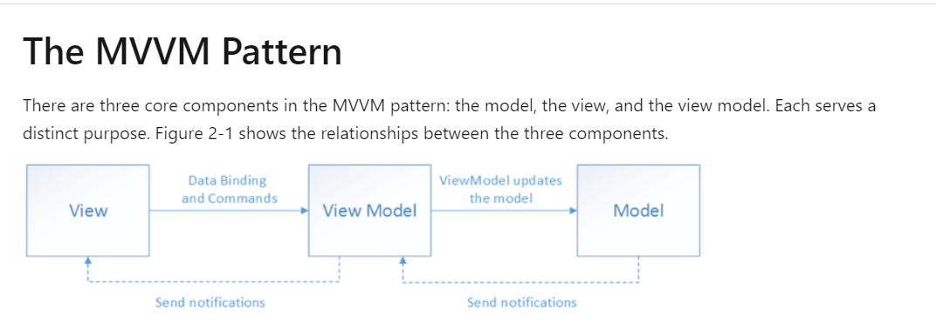
MVVM

Slide 76
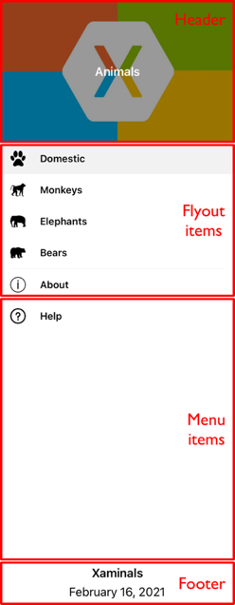
FlyoutPage

Slide 77
Questions

Slide 78
Module Summary
Xamarin Architecture
Xamarin Forms
Data Binding MVVM
Data Access Sqlite
Rendering and Publishing Mobile Application

